Slide 1

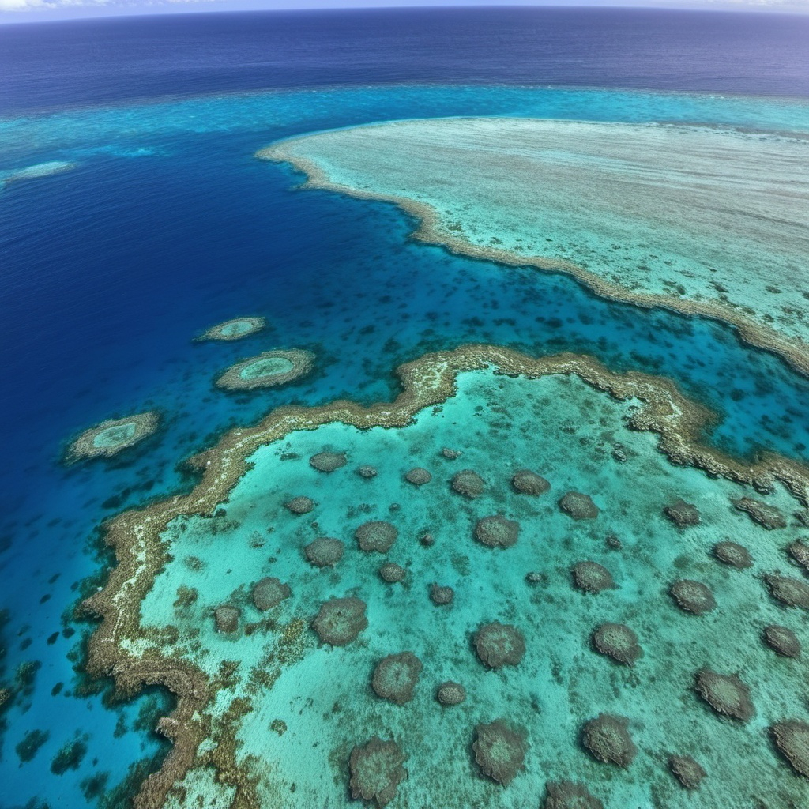


Eco Reef 3D
EcoReef
SAVE THE CORALS IN THE OCEANS
ETHAN, LOU, ALIX, QUENTIN, ADRIEN

Slide 2
Introduction and context
03
Problem Statement
04
Global warming
04
Impact
04
Technical Innovation
05
3D Printer
05
Summary
Environnements
05
Materials
05
Sustainability
05
Funding the project
06
Governements
06
Private companies
06
EcoReef
Conclusion and call to action
07
SAVE THE CORALS IN THE OCEANS
Thank you for listening
07

Slide 3
Introduction
03

Slide 4
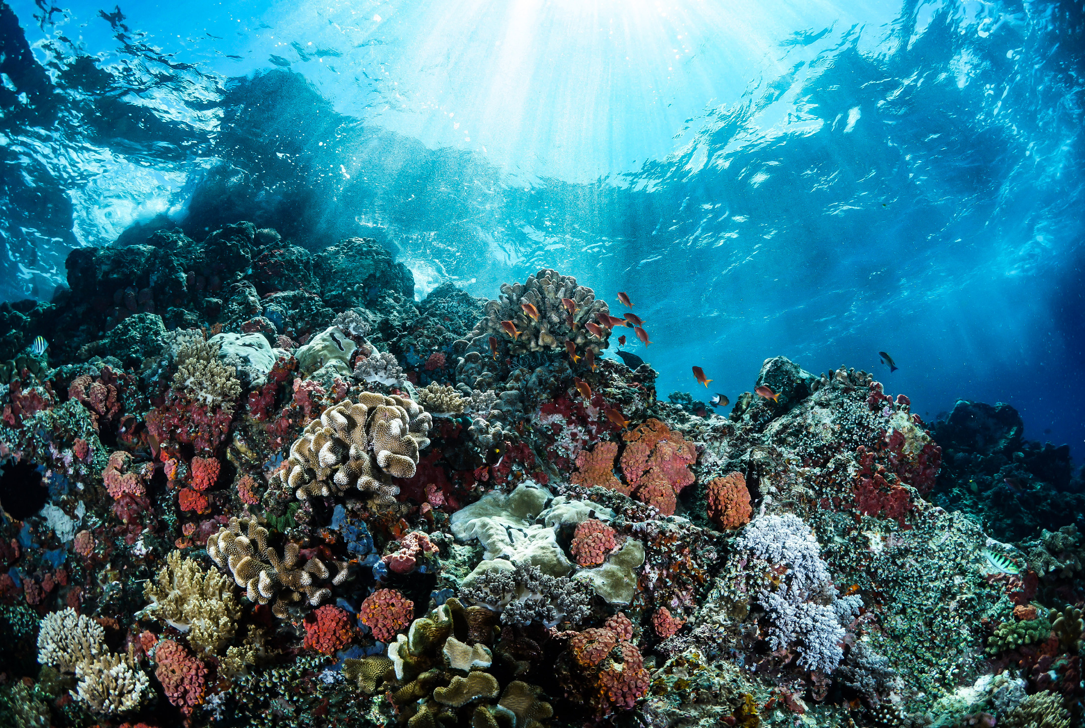
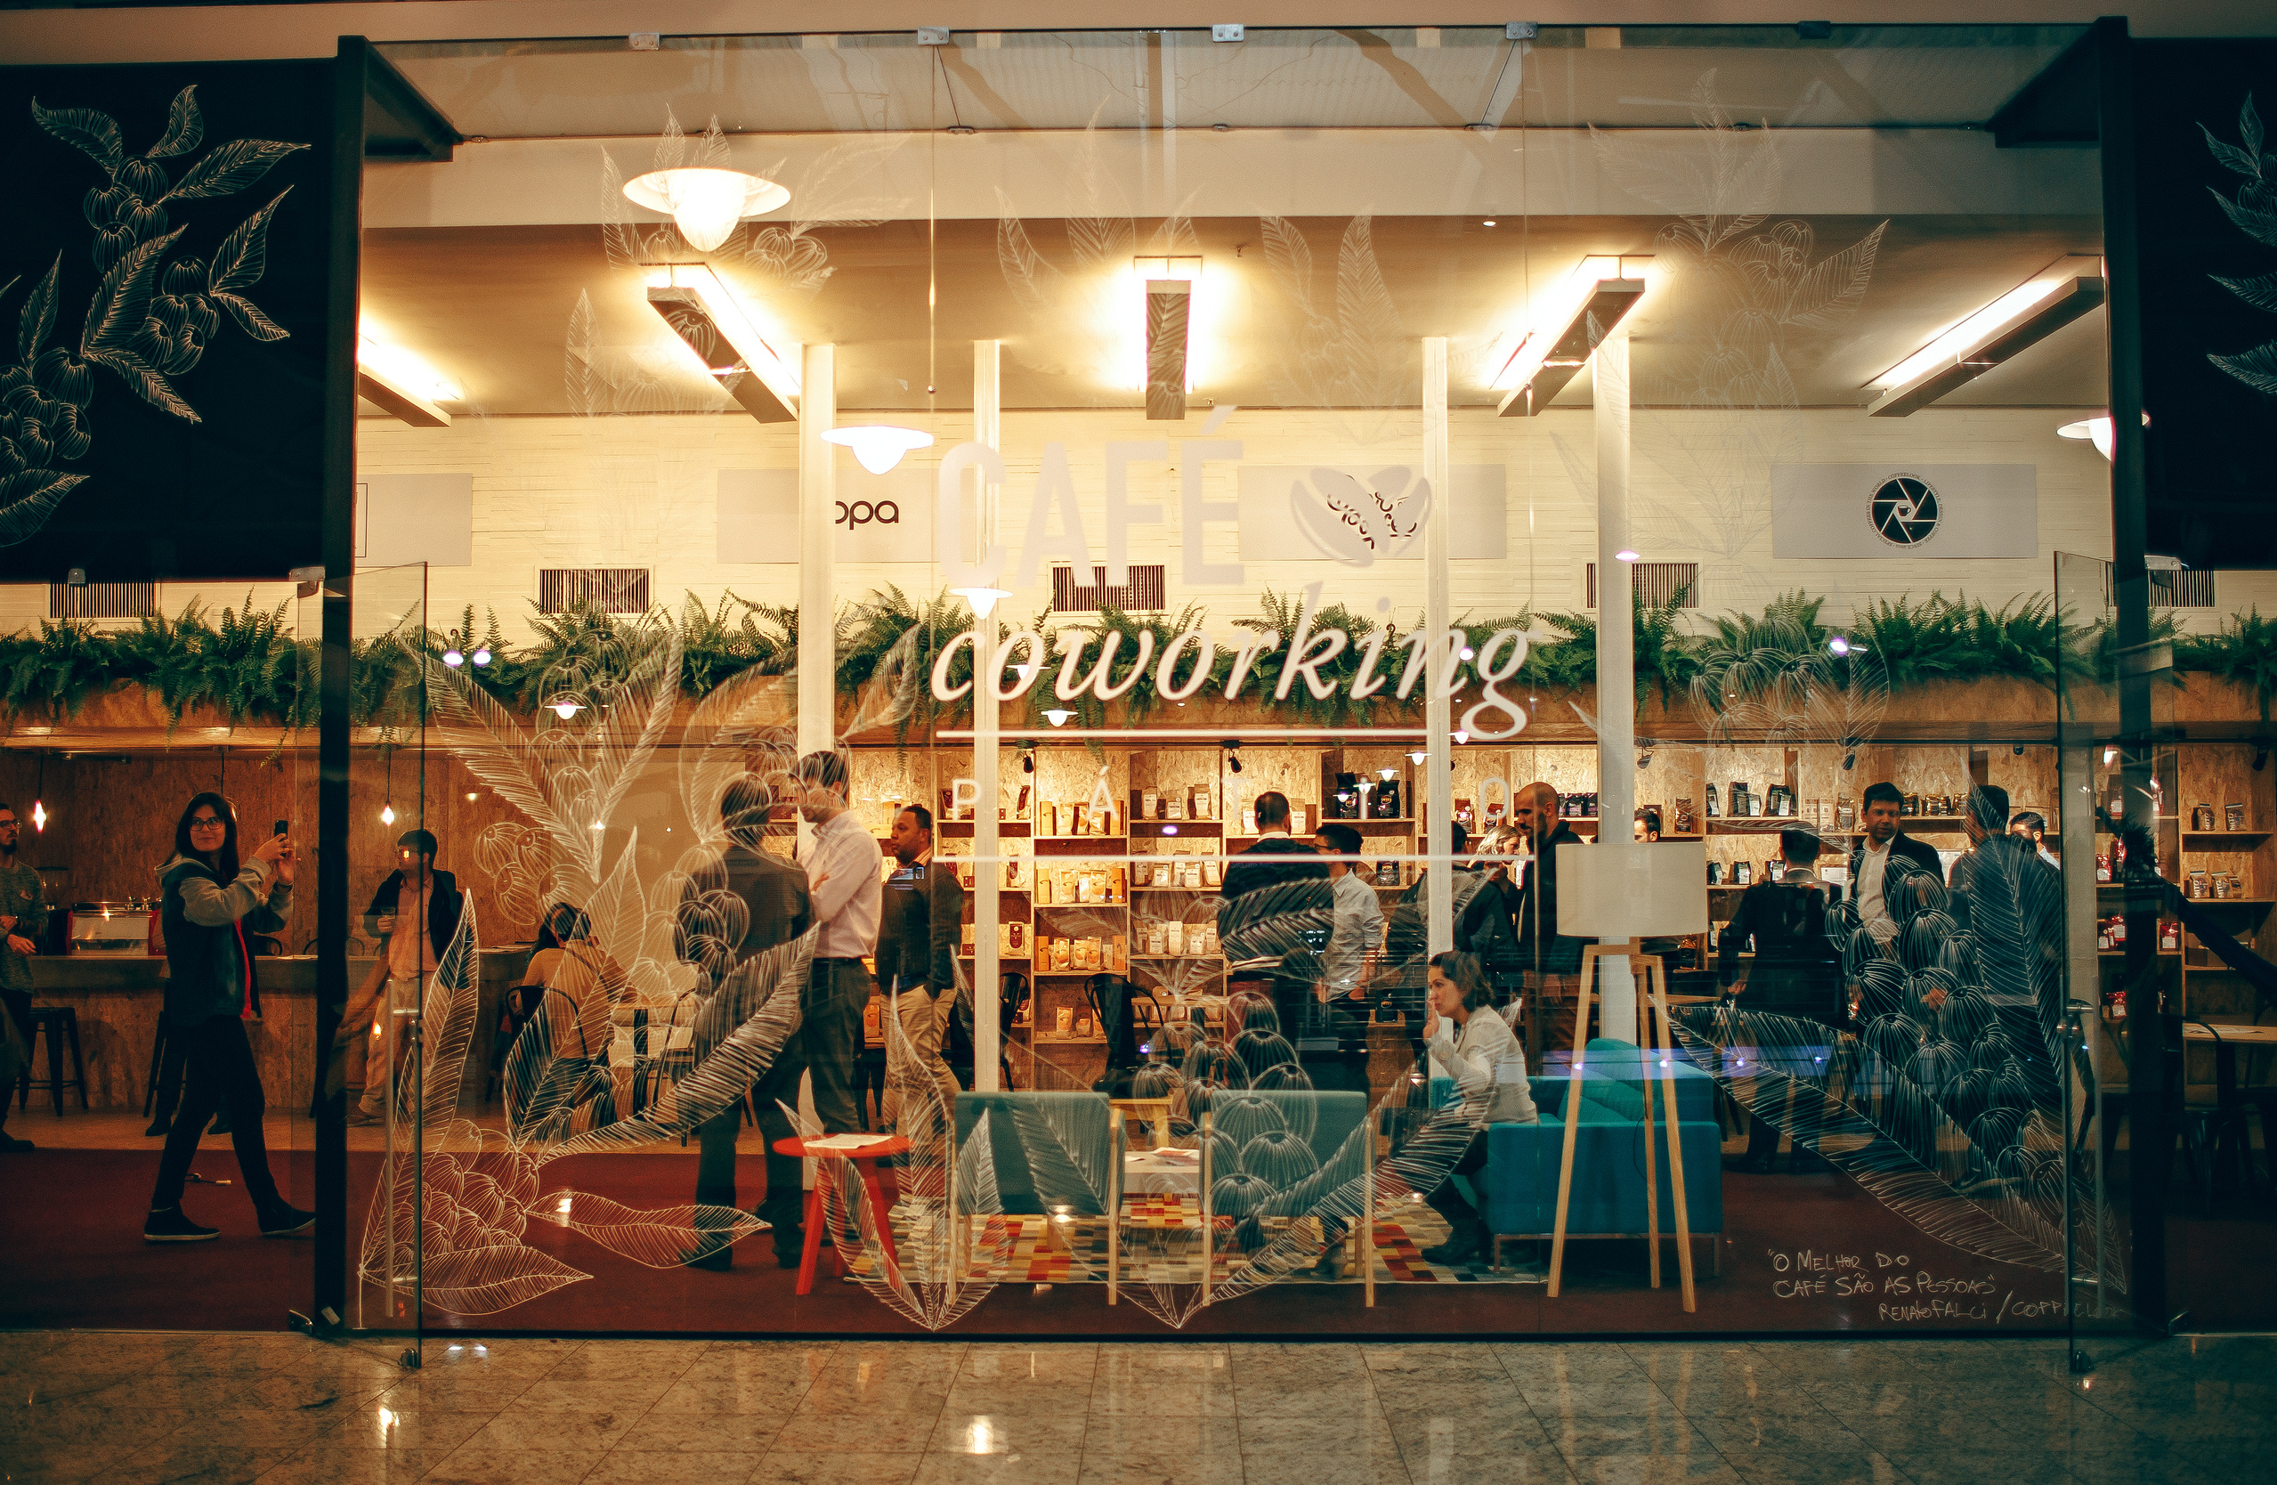
Problem Statment
Over 50% of coral reefs are already destroyed.
Nearly 90% may disappear by 2050.
Problem Statement
Coral loss affects marine life and millions of livelihoods.
Traditional restoration is slow and leaves artificial debris.
EcoReef 3D offers a sustainable, eco-friendly solution.
04

Slide 5
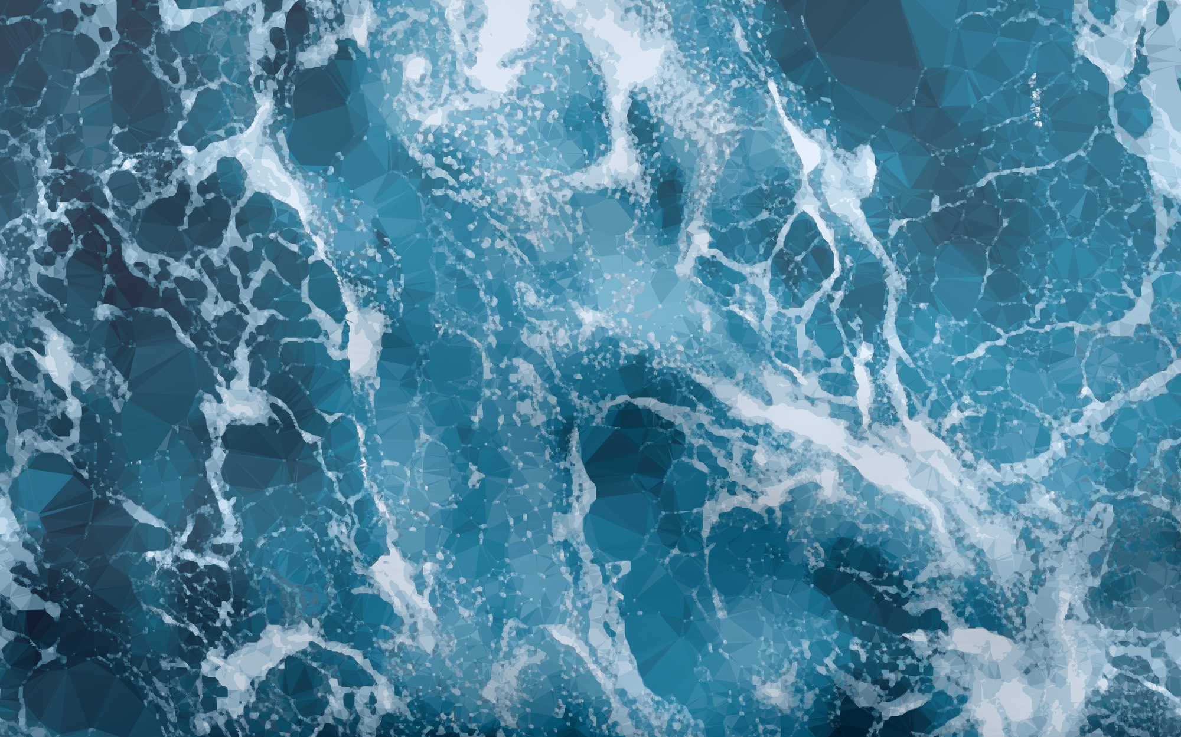
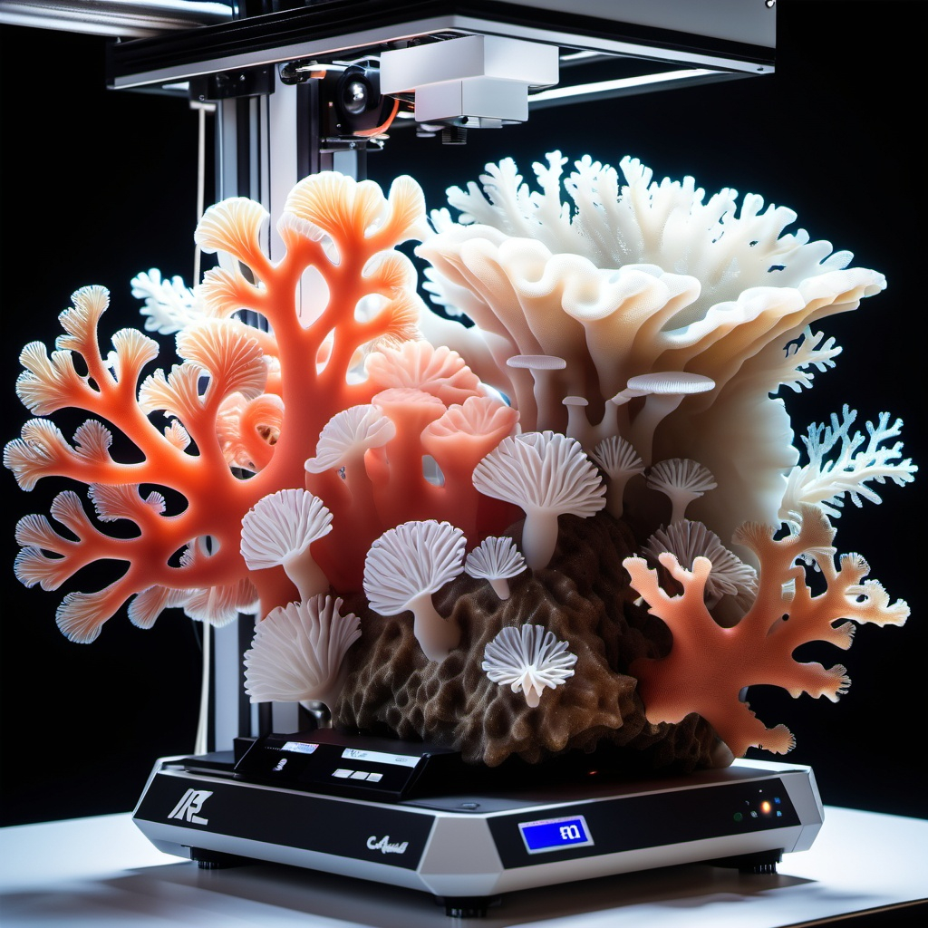
Environnements
Technical Innovation
Analyzes temperature, salinity, biodiversity.
Creates structures adapted to marine habitats.
Supports coral regeneration.
Materials
Uses biodegradable calcium carbonate.
Mimics natural coral structure.
Leaves no artificial waste.
05

Slide 6
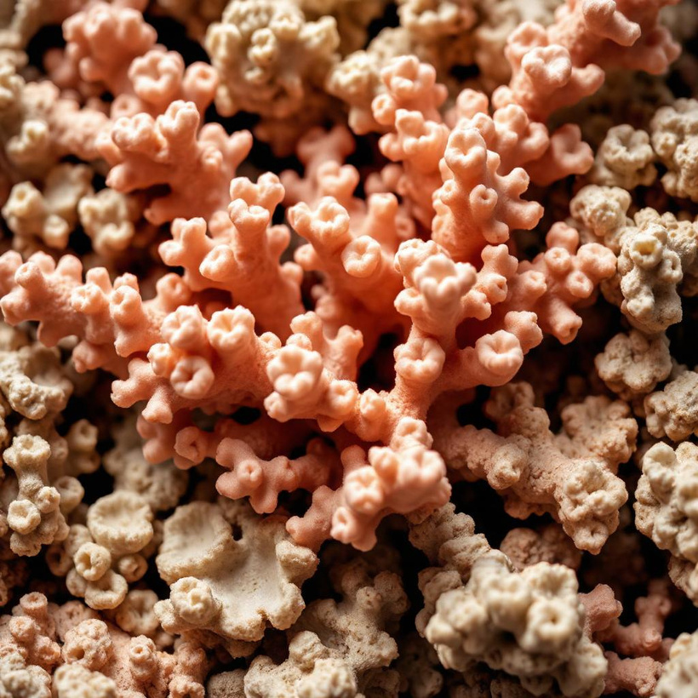
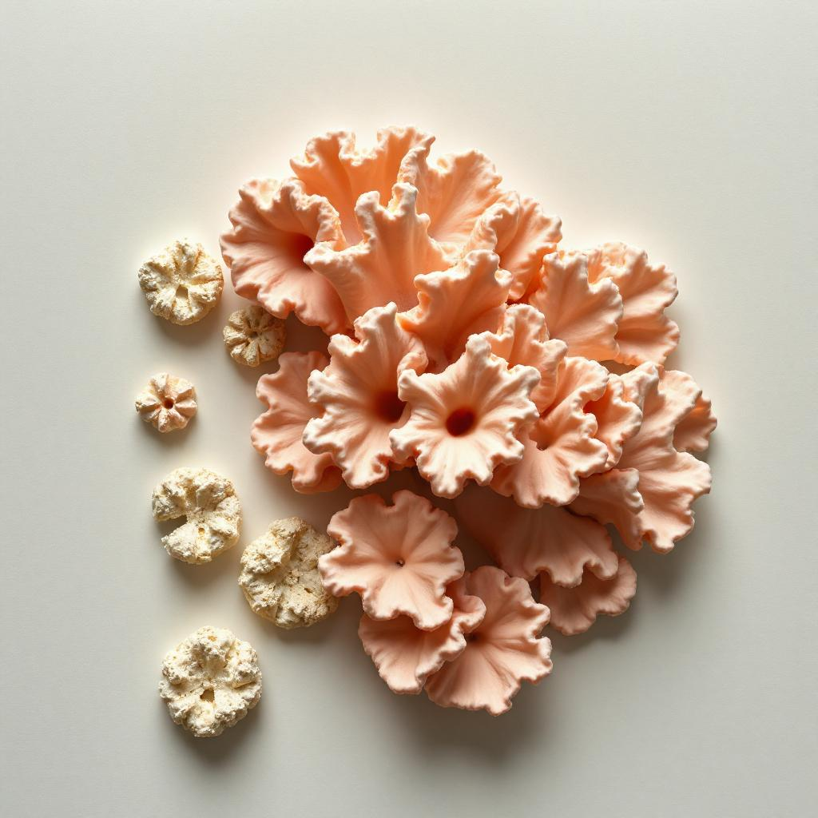
Funding the Project
Supports
Gouvernments
Compagnies
Crowdfunding
Budget
$500,000 for research
$25,000 per printer
06

Slide 7
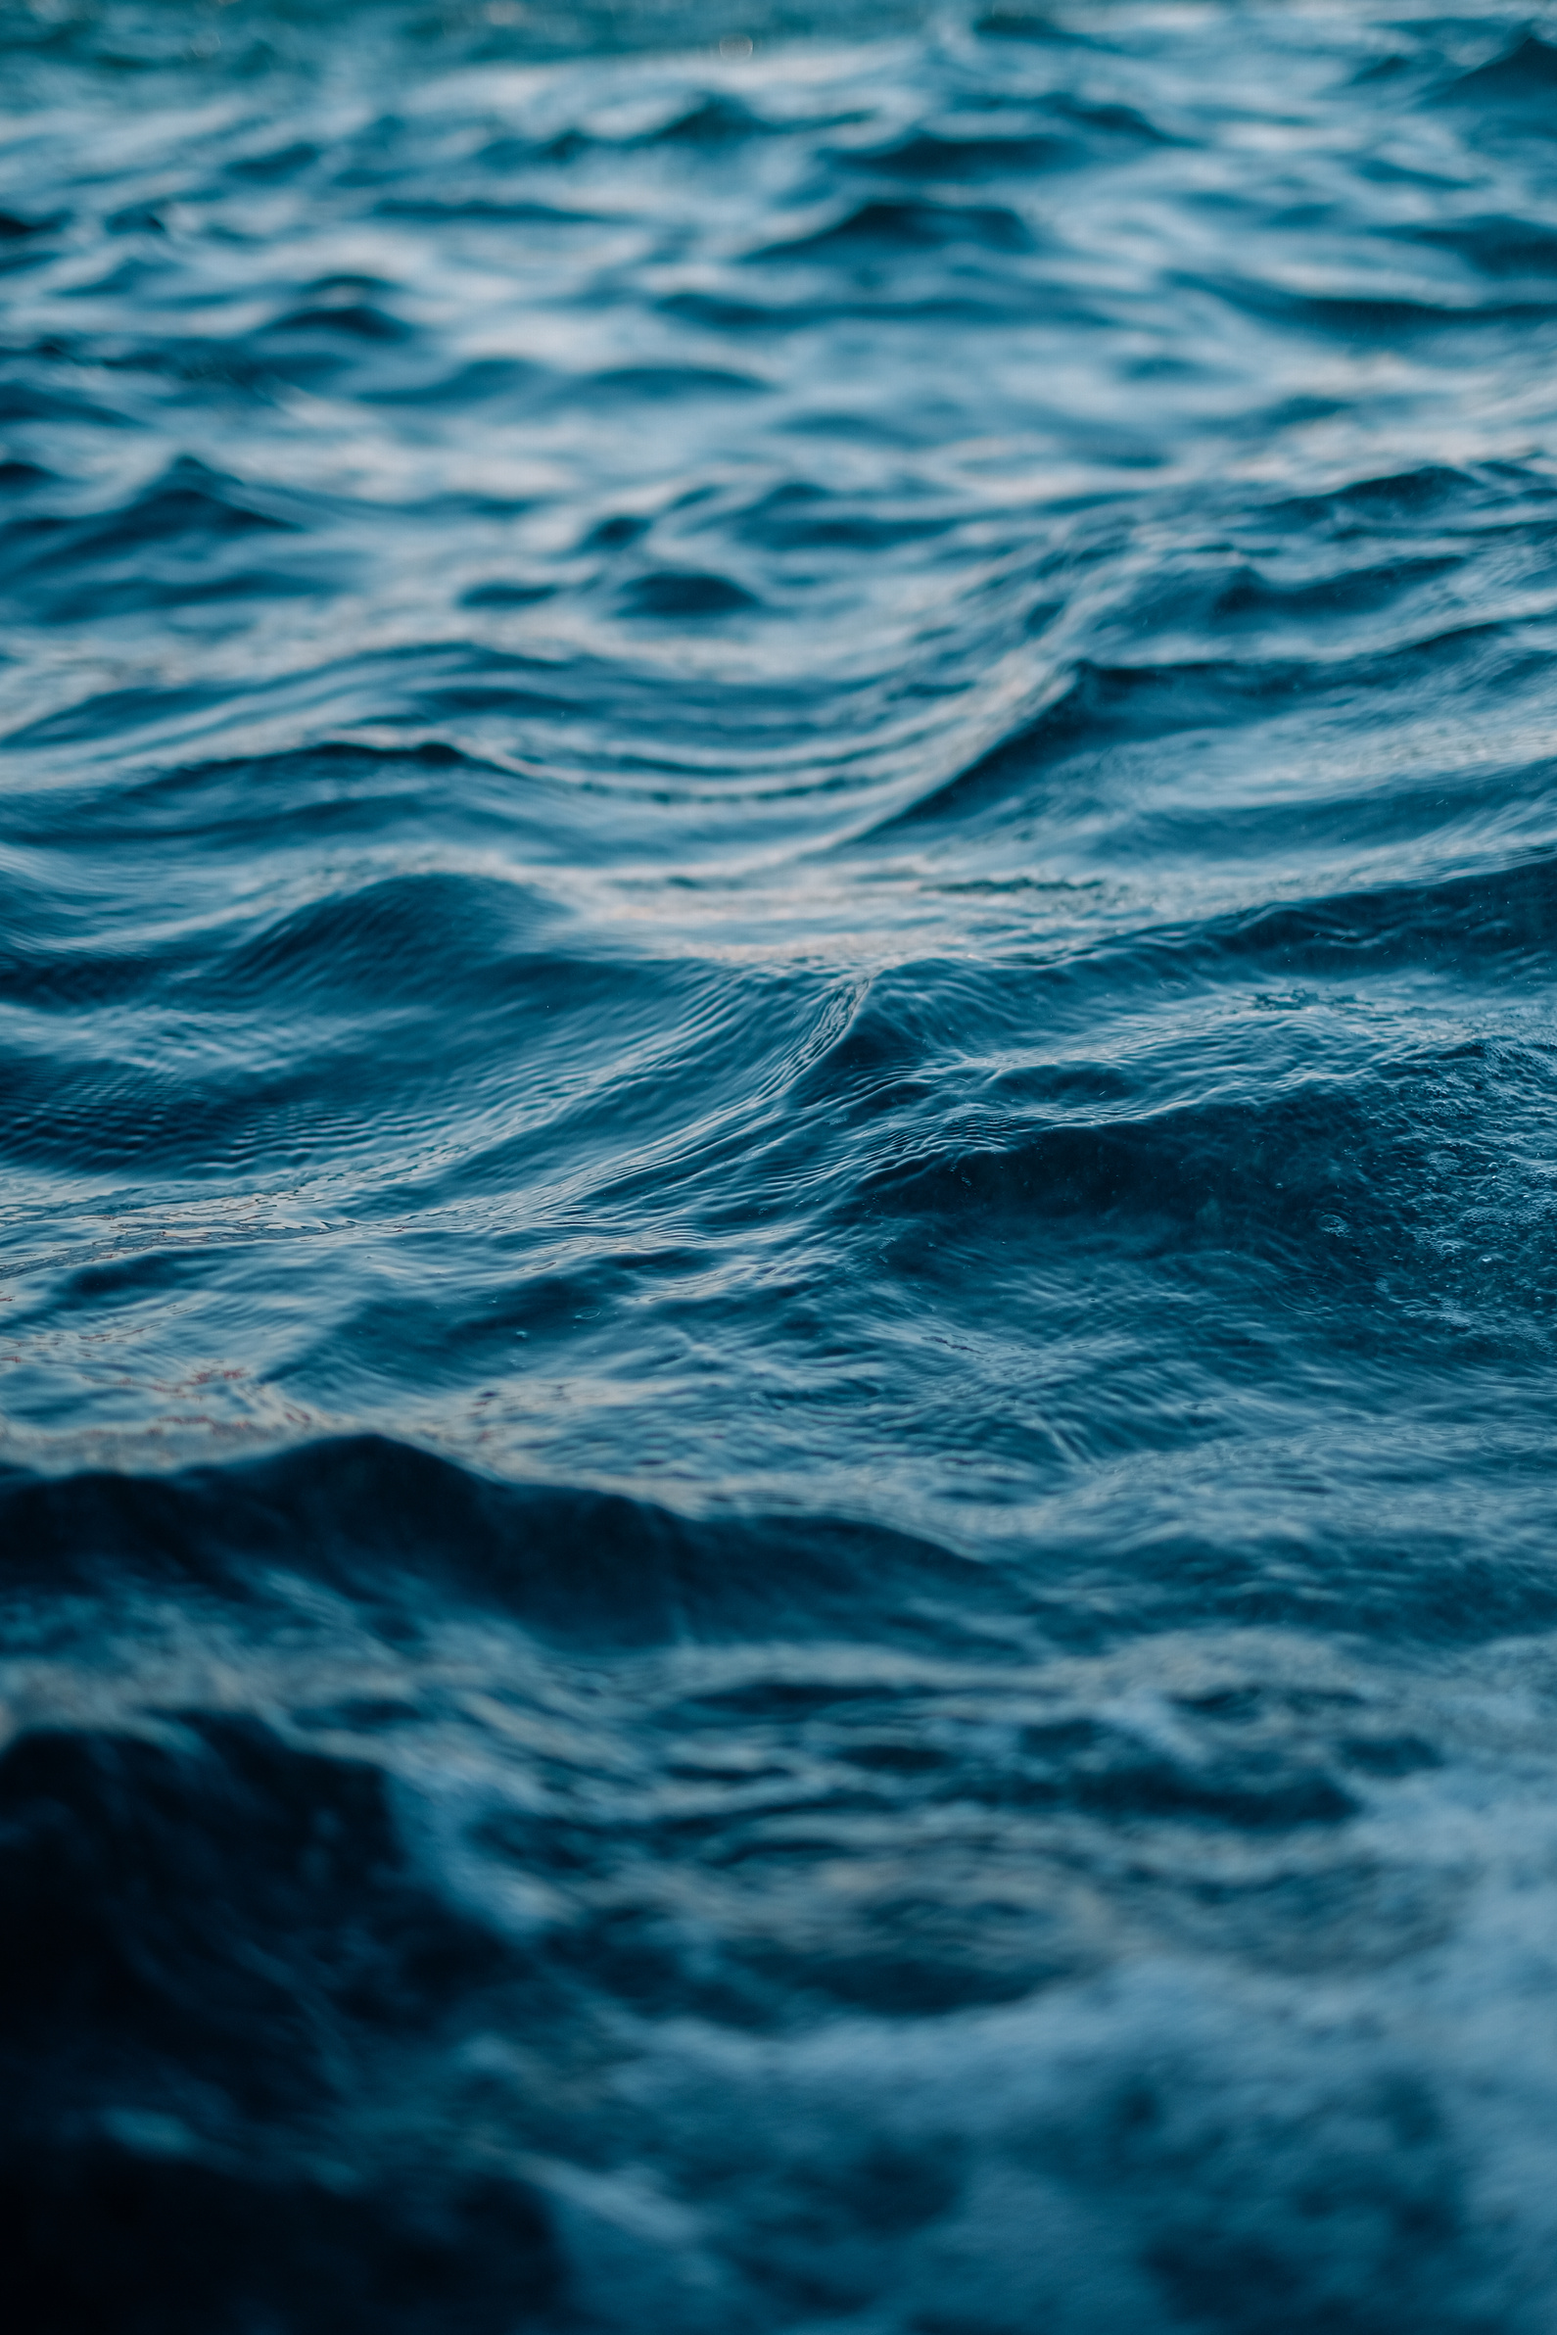
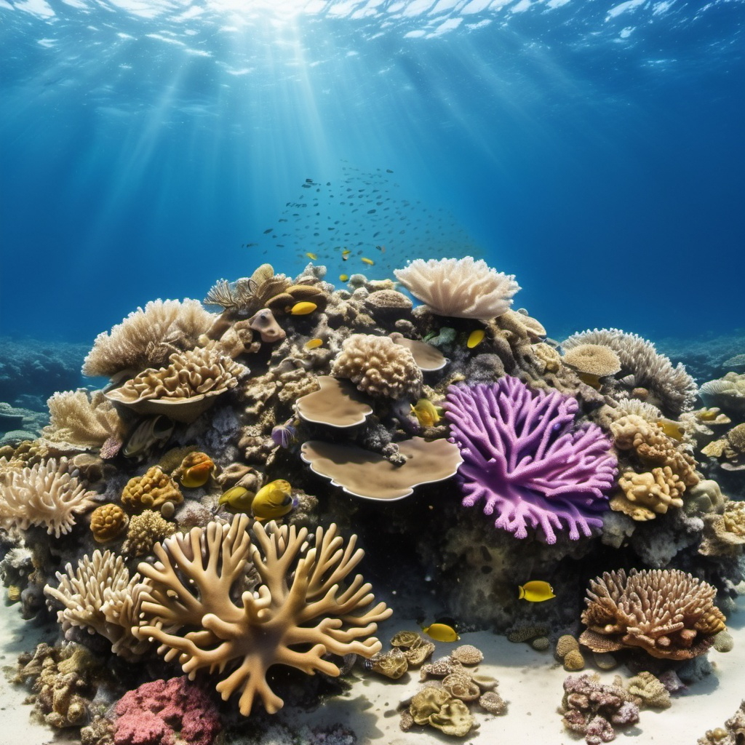
EcoReef
SAVE THE CORALS IN THE OCEANS
Conclusion and call to action
“Restoring Coral Reefs, Protecting Marine Life for the Future”
07

